Slide 1
Neighborhoods Recommendation Engine
Coursera capstone Project

Slide 2
Introduction
Introduction Section : Business Problem
The New York City real estate is one of the most expensive real estate markets in the U.S. and around the globe. Due to the high costs of living, many people that work in NYC would prefer to commute and own a home outside of the city. However, these same people also want the benefits that come along with big city life.
Philadelphia has much of the same benefits of NYC with a diverse community, major league sports, large population, similar climate, large cultural events and locations, and a significant number of highly-rated restaurants and other establishments. In addition, commuters can get trains directly from Philadelphia to downtown NYC in about an hour to an hour and half. Yet, property prices in Philadelphia per square foot are significantly lower than those in NYC (by a factor of 4).
Therefore, over the past several years, Philadelphia has seen an influx of people from NYC. Especially people with families that are not looking to spend their entire salary on a small place in the city and want some of the amenities that big cities have to offer.
Problem Statement : How does someone from NYC know which neighborhoods are similar to the ones they like in NYC? By creating a clustering model of both NYC and Philly neighborhoods, we should be able to provide them with like neighborhoods. This should help to narrow or simplify their search for a place in Philadelphia that is similar to those they know in NYC in terms of demographics and the variety and quantify of establishments within major categories like restaurants, bars, religious, financials, and others.

Slide 3
Data
The data required to create this analysis is drawn from the following sources:
Opendatasoft API : provides the list of neighborhoods, geographic coordinates, and demographic data from Zillow
Google Maps API : provides postal codes for the neighborhoods based on the latitude and longitude
Foursquare API : provides the venue data based on latitudes and longitudes of each neighborhood
There were 432 neighborhoods located in the Zillow dataset: 278 were from NYC and 158 in Philadelphia. 4 rows were duplicates
There were 10,777 venues/places located in walking distance to these neighborhoods
Duplicate or missing features in the data set were dropped

Slide 4

Venue Data was combined…

Slide 5
…demographics data

Slide 6
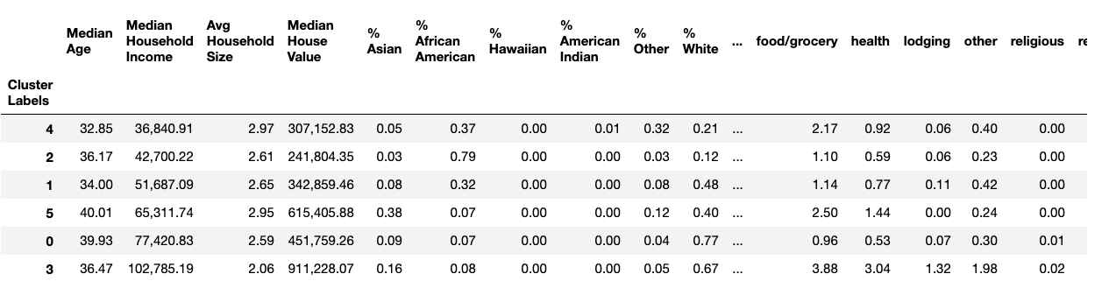
Clustering to find similar neighborhoods
The data was normalized and then run through a Kmeans clustering model to find similar neighborhoods between the cities and determine the characteristics for the clusters (groups of similar neighborhoods)

Slide 7
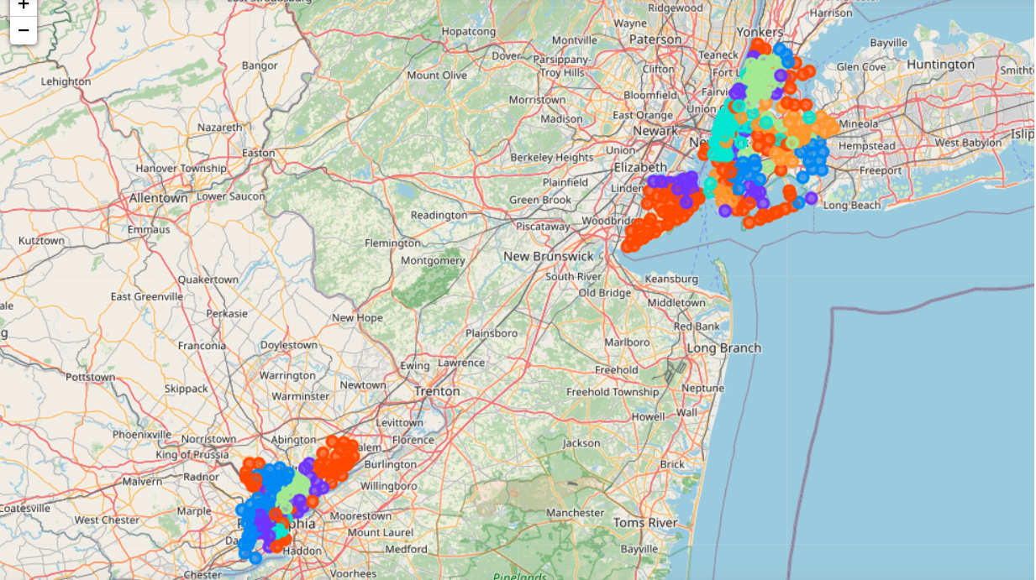
The data was mapped to show the location of the similar neighborhoods

Slide 8
Results
Cluster 0 : 2nd highest Median Age, 2nd highest average household income, below average household size, average house value, and the least racially diverse cluster with 77% white, below average number of locations within walking distance
Cluster 1 : 2nd lowest Median age, average income levels, household size, and home values, racially diverse, average number of places within walking distance
Cluster 2 : Average age, 2nd lowest average income, average home size, low median home value, low racial diversity , heavily African American, lowest total number of locations within walking distance
Cluster 3 : Average age, highest avg income, lowest household size, highest median home value, second least racially diverse but 16% Asian population, highest (4X others) average locations especially bars, restaurants, etc.
Cluster 4 : Youngest Median Age, lowest household income, very diverse population, largest household size, average number of locations
Cluster 5 : Oldest Median age, average household income, high household size and home value, largest Asian population percentage but racially diverse, second highest number of places within walking distance especially restaurants. Especially of note in this cluster is that they are all NYC neighborhoods with no matching Philadelphia neighborhoods.

Slide 9
Conclusion
The purpose of this analysis was to build a model that could recommend neighborhoods for relocation to people in NYC looking to relocate to Philadelphia and commute to NYC.
The model shows that it is possible to create a model based on these parameters.
Similar features were found in online models by real estate agents but not ones where the customer could select a neighborhood in their city that they were familiar with and then have the system provide similar neighborhoods in other cities.
This model could be refined further to allow the customer to weight the importance of the factors making the model more flexible and make the decision and research process simpler for the end users.

